Slide 1
SOFTWARE DEVELOPMENT II
Project Presentation on -
Student Information Management System
(SIMS)
Using C#

Slide 2

Bangladesh University of Business And Technology (BUBT)
Project “SIMS”
Submitted By:
Supervised By:
Sirajum Munir Tamim | 252
Md. Rabiul Hasan Emon | 258
Tonmoy Ahammed Alam | 245
Suman Saha Assistant Professor Department of CSE BUBT Mirpur-2, Dhaka-1216

Slide 3
PRESENTATION OUTLINE
Introduction
Motivation
Proposed System
E-R Diagram
User Interface (UI)
System Diagram
Limitation
Future Plan & Conclusion

Slide 4
Introduction
Student Information Management System is basically a idea of storing information of students and show or print the data grid according to the given command. Project “SIMS” is able to-
Start with an user login from and proceed to next.
Record student information individually.
Update the student database.
Show the statistical information from database.
Generate student information in data-grid accordingly.

Slide 5
Motivation
The objectives of this project are :
To design a system that can be handled as student information storage.
To design a system that can keep and track of students particularly.
To design system that is much better than manual data recording system.
To design system that is easy to view and find student information accordingly.

Slide 6
Proposed System
Ensure data accuracy and data security.
Minimize manual data entry into database.
Greater efficiency and faster operation.
User friendly and interactive.
Better “FUNCTIONAL” service.

Slide 7
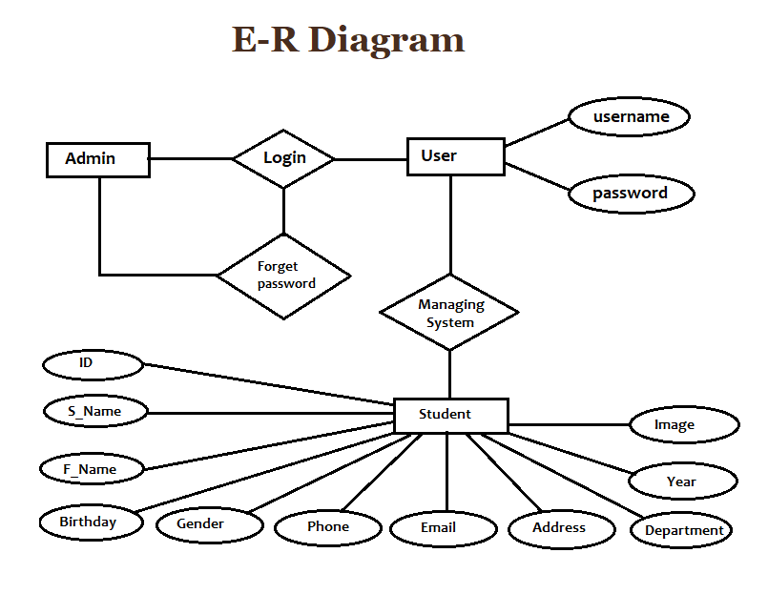

Slide 8
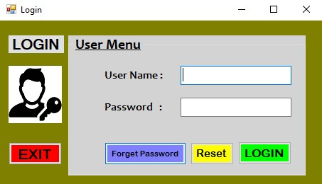
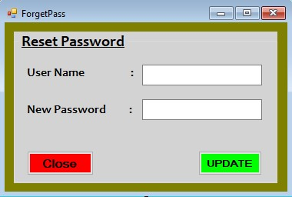
User Interface (UI)
User Menu and Forget password
This is the first form to enter the manager applications, which handles a verified user.

Slide 9
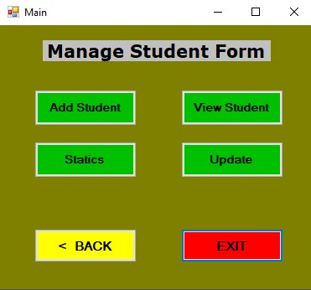
Main Menu Form of an User
This is the main menu form to manage student data with database connection. It includes 4 sections –
Add Student
View Student
Statics
Update

Slide 10
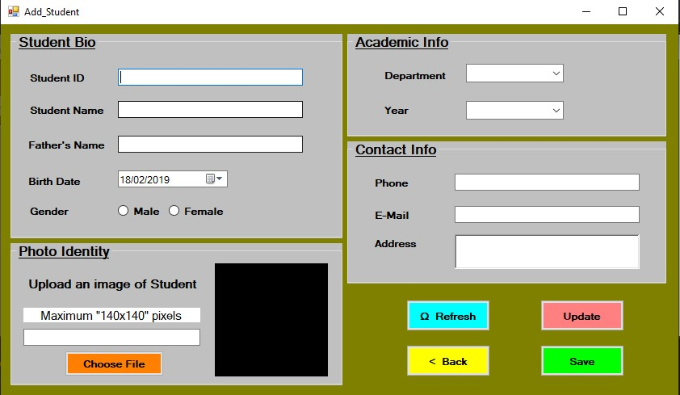
Add Student Form
This is the student form where user can input all the necessary information in the database through this form and make useful later on.

Slide 11
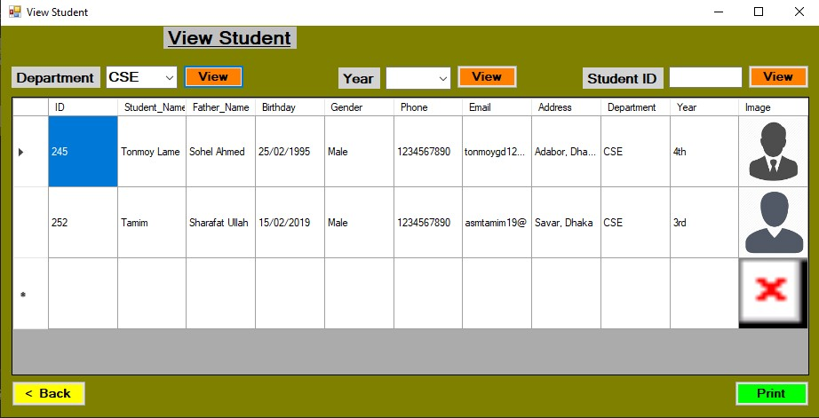
View Student in Grid-View
This is the form where user can see or show the student information in grid-view according to given command, such as-
Department selection, Year selection, or just randomly put an ID.

Slide 12
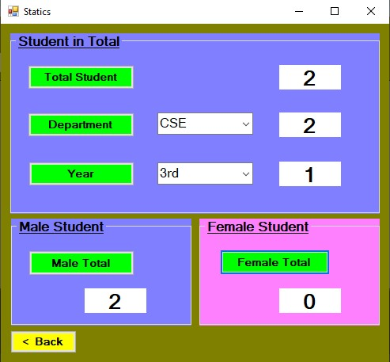
Statistical Information
This is the form where user can count the information of student in various statistical value from stored database. Such as, total student count, department wise count, year wise count, total male and female count etc.

Slide 13
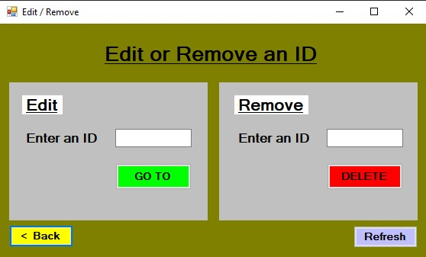
Update Student Database
This is the form where user can update a student info in 2 ways.
User can edit the data he or she provided and user can delete an entered data from database through the delete button.

Slide 14
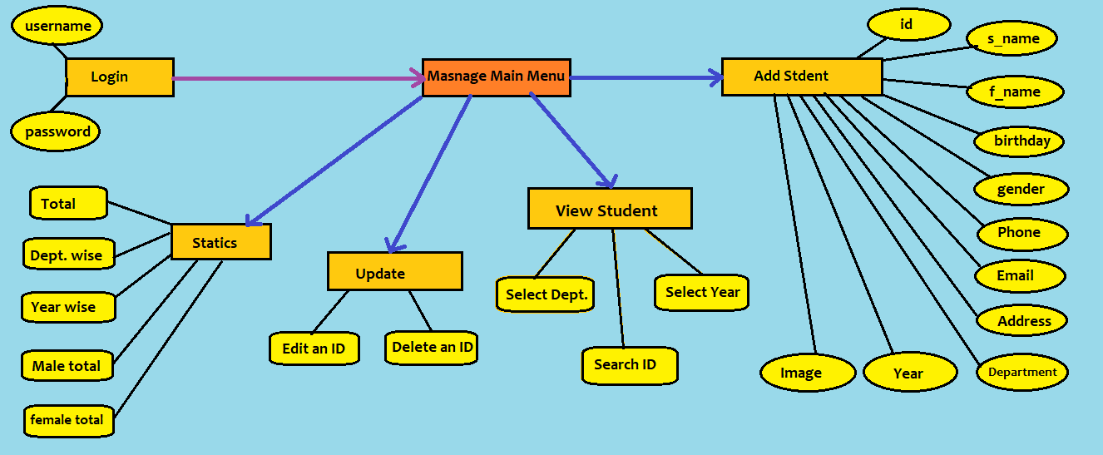
System Diagram

Slide 15
PROJECT VIEW

Slide 16
Limitation
Platform depended (windows- visual studio).
No public view option.
Limited features.
Time delay.

Slide 17
Future Plan
Update the graphics and user-interface.
Notifications system.
Advance data record systems.
Expand the system as an institute’s information manager.
Enable a public view options.

Slide 18


